Slide 1
Capstone Project Unleashing Insights from Football Data Using Multiple Tools
NAME : SANDHYARANI.SAINI
Enrolement ID : EN12025082886
Batch Name : DA364S36

Slide 2
Introduction
Data analytics has become an essential tool in unlocking valuable insights from raw data, enabling informed decision-making in various fields, including sports.
This project focuses on applying data analytics to football data, with the aim of uncovering key patterns, trends, and performance indicators that shape the game.
By utilizing techniques such as data cleaning, exploration, statistical analysis, and advanced visualization, this project seeks to provide actionable insights that can drive strategic decisions in football.
Through detailed visualizations, the project presents findings in an accessible and understandable manner, making it easier to identify factors that influence game results and player success.
The goal of this analysis is to assist football analysts, coaches, and strategists in optimizing their approaches by highlighting the key elements that contribute to winning strategies, player effectiveness, and match predictions.
By addressing questions related to player contributions, team strategies, and match outcomes, the project aims to provide a deeper understanding of the sport and its intricacies.
Various data analysis techniques, like exploratory data analysis(EDA) and correlation , prediction using ML models using tools like Python, MYSQL, Excel, and Tableau are employed to exact meaningful insights. These insights aim to enhance decision-making, improve team performance, and provide a competitive edge in the sport

Slide 3
AGENDA
Dataset Overview
Key features and variables in the dataset
Data sources and collection process
Data Cleaning & Preprocessing
Handling missing values and outliers
Data transformation and feature engineering
Exploratory Data Analysis (EDA)
Key trends and patterns in the data
Visualizing player and team performance
Predictive Modeling
Building models to forecast match outcomes
Evaluating model performance
Key Insights
Key takeaways for teams and coaches
Trends and strategies based on data
Conclusion
Summary of findings

Slide 4
FOCUS AREAS
Performance Analysis
Contract Management
Player Profile and Market Value
Competition Analysis
Attendance and Stadium Analysis
Event Analysis
Team Comparison
Substitution Patterns
Referee Analysis
Player Attributes and Demographics

Slide 5
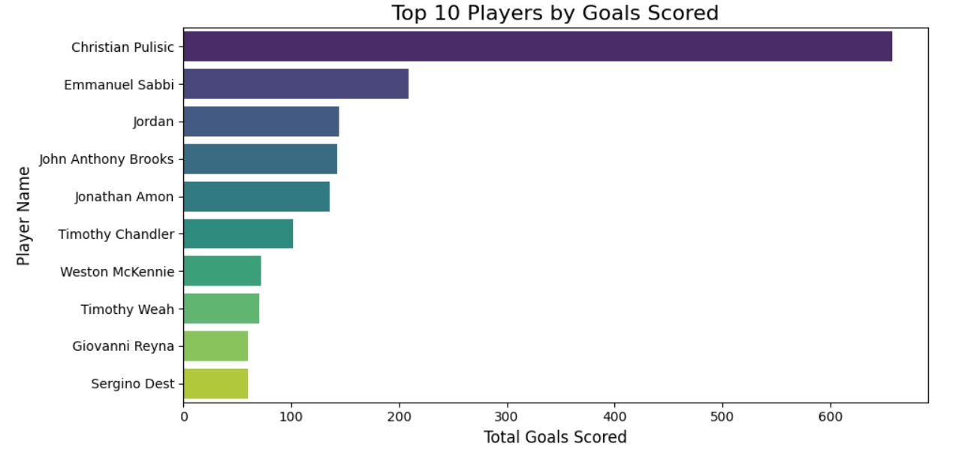
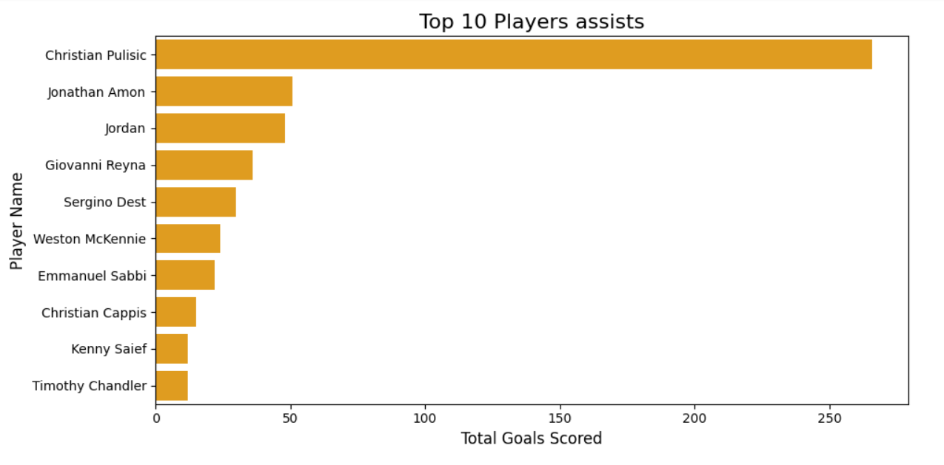
Performance Analysis
Interpretation:
Christian Pulisic significantly outperforms other players, scoring over 600 goals. This suggests he's a highly prolific scorer.
Christian Pulisic stands out as the top assist provider, significantly outperforming the other players. This suggests he plays a pivotal role in creating scoring opportunities for his team.

Slide 6
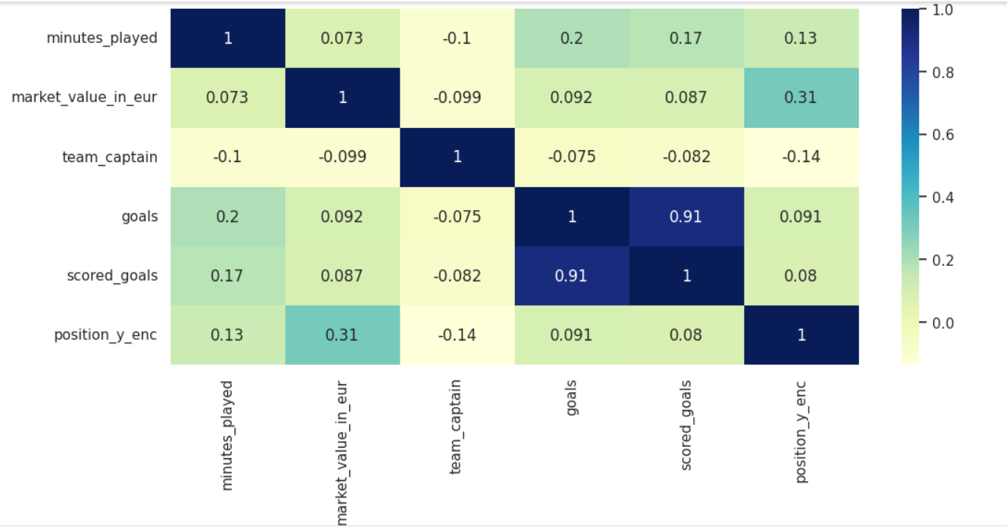
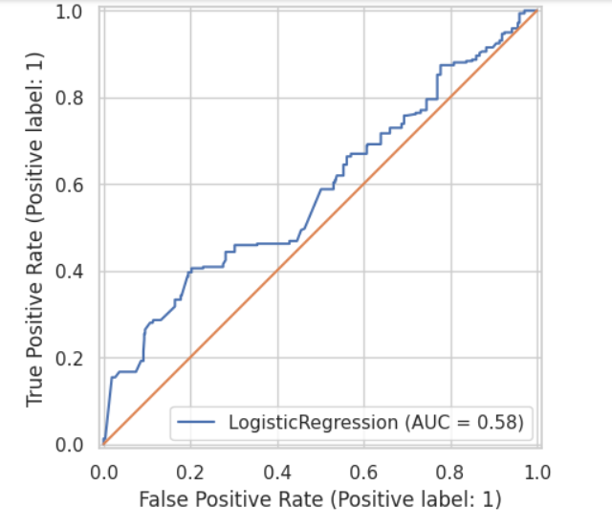
Logistic Regression for Performance Analysis
Accuracy=63%
Recall =16.67%
F1_score=25.8%
Precision = 57%
Accuracy tells the model is moderate performance. F1-score is low, indicating that the overall performance of the model is unbalanced
x=minutes_played,position_y,team_captain,market_value_in_eur[Independent variables]
Y=goals[Target Variable]
Interpretation: The correlation matrix suggests potential multicollinearity, and the low AUC of the logistic regression model indicates limited predictive power, suggesting a need for feature engineering and model refinement…

Slide 7
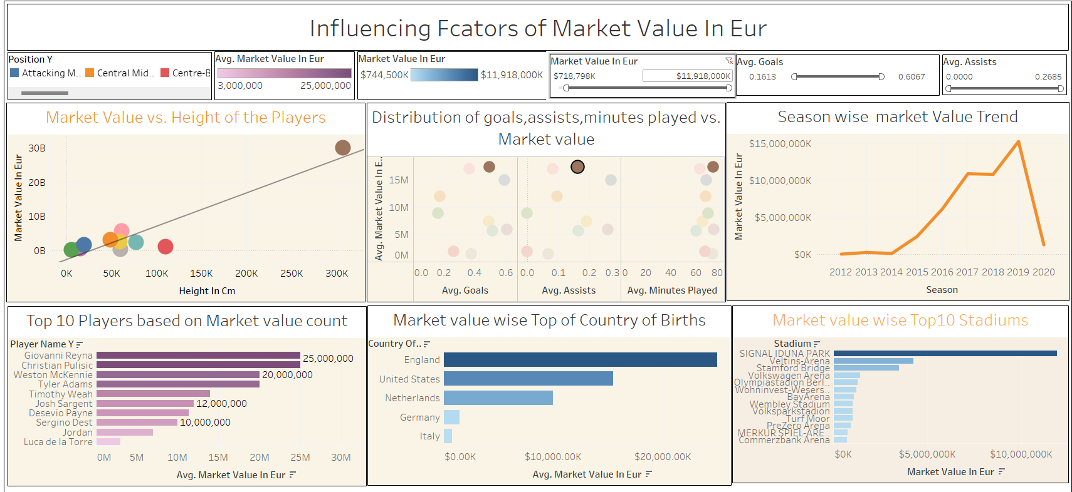
Player Profile and Market Value
Interpretation:This dashboard explores the factors influencing player market value, revealing insights into the impact of position, performance metrics, physical attributes, and market trends on player valuation in football.

Slide 8
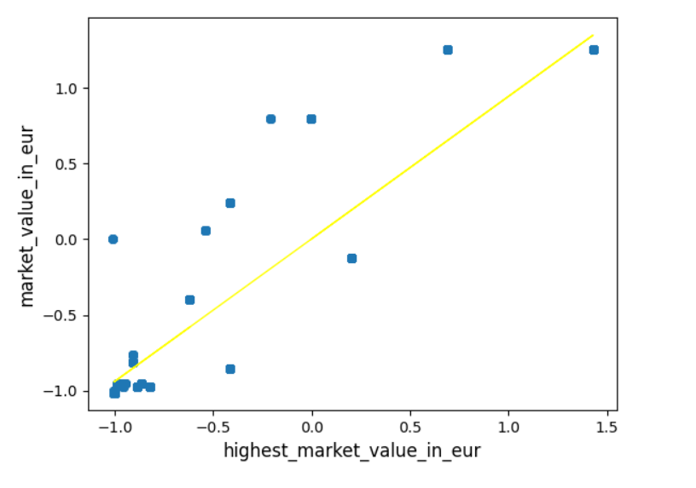
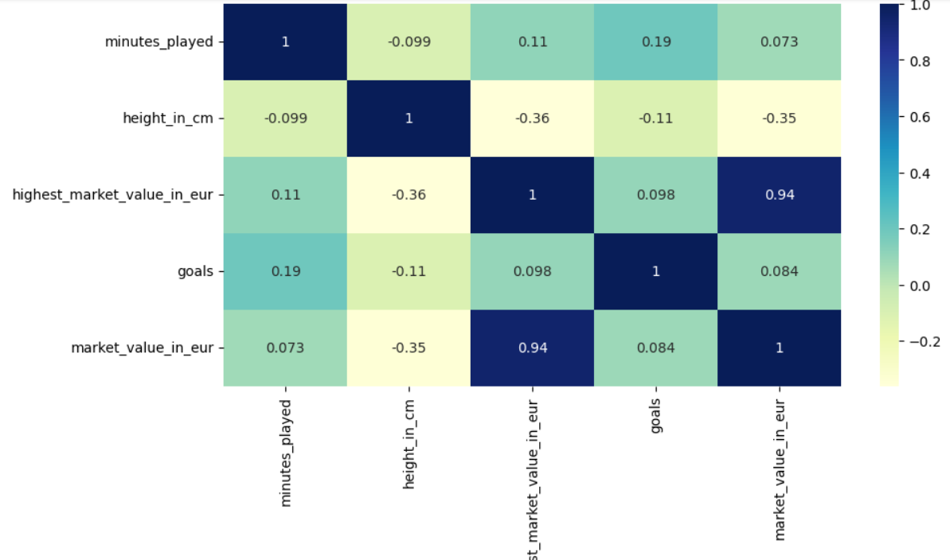
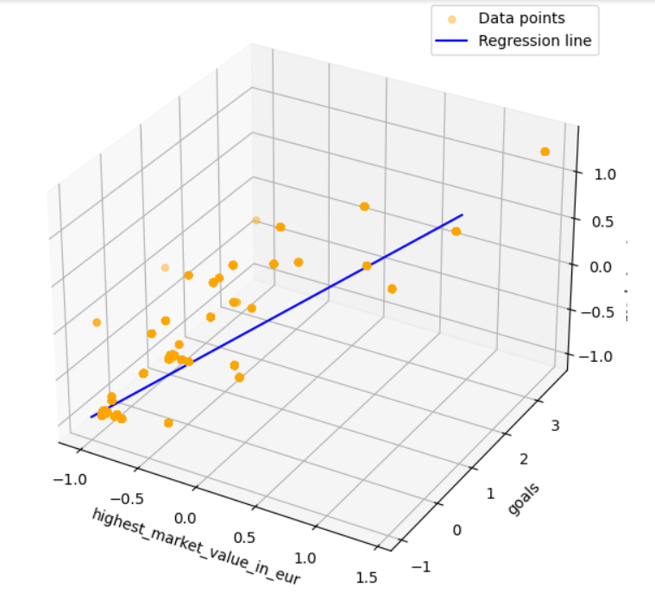
Simple Linear Regression and Multiple Linear regression for Player Profile and Market Value
Interpretation: This first visual depicts a simple linear regression model. A straight line (regression line) is fitted to the data points, suggesting a relationship between "highest_market_value_in_eur" ( independent variable) and "market_value_in_eur" (thedependent variable). The scatter of points around the line indicates the model's accuracy…….
3D Scatter Plot: The 3rd visual represents a multiple linear regression model. The 3D space represents the relationship between multiple independent variables (possibly "highest_market_value_in_eur", "minutes_played", "goals") and the dependent variable ("market_value_in_eur"). The regression line in 3D space attempts to capture the best fit for the data points in this multi-dimensional space…….

Slide 9
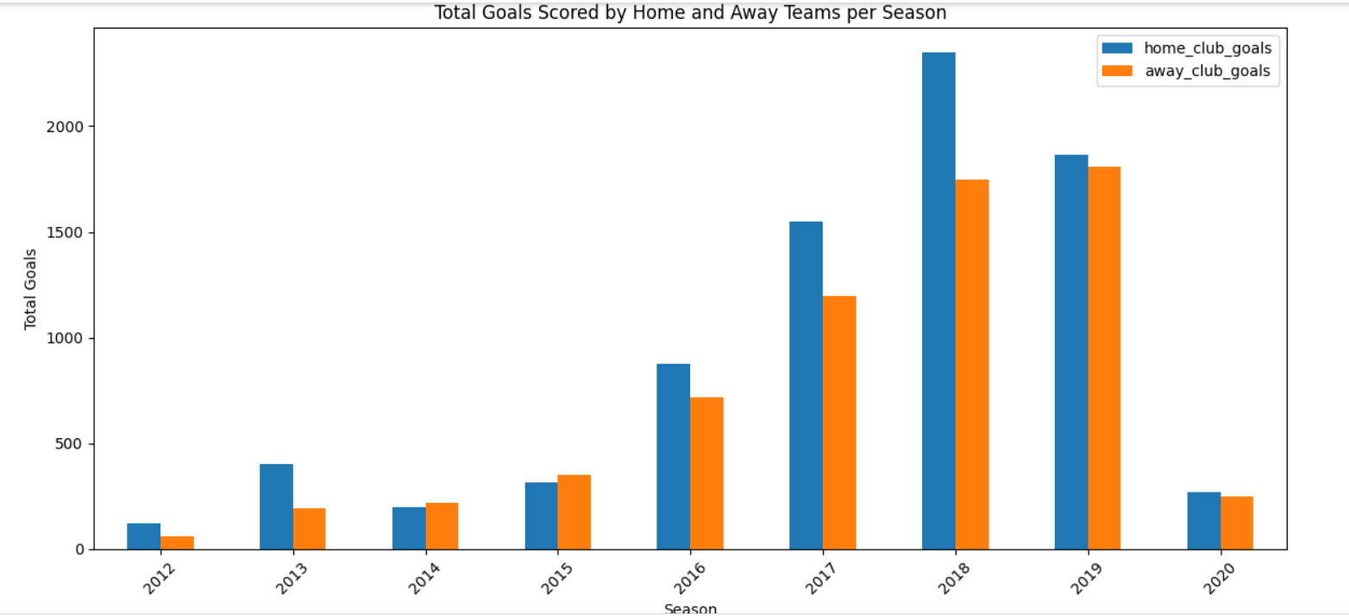
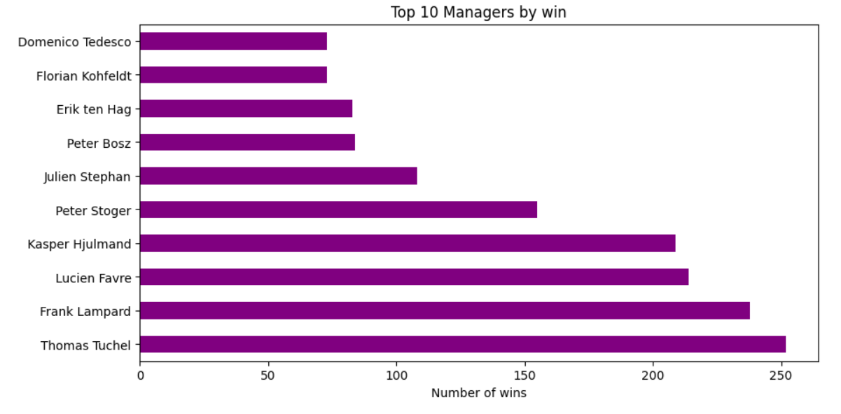
Team Comparision Analysis
Interpretation:
In 2018 home clubs have high scored goals.. Home Advantage: In most seasons, the number of home goals is significantly higher than the number of away goals. This highlights the importance of home-field advantage in football.
Thomas Tuchel have a significantly higher number of wins compared to the rest. This suggests a clear hierarchy in terms of managerial success.

Slide 10
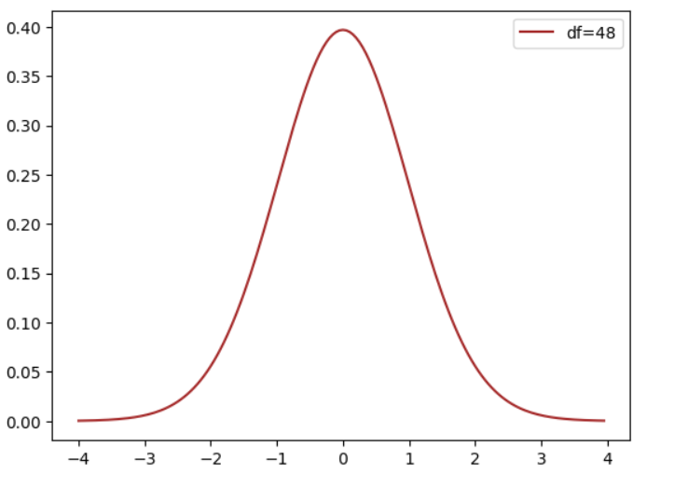
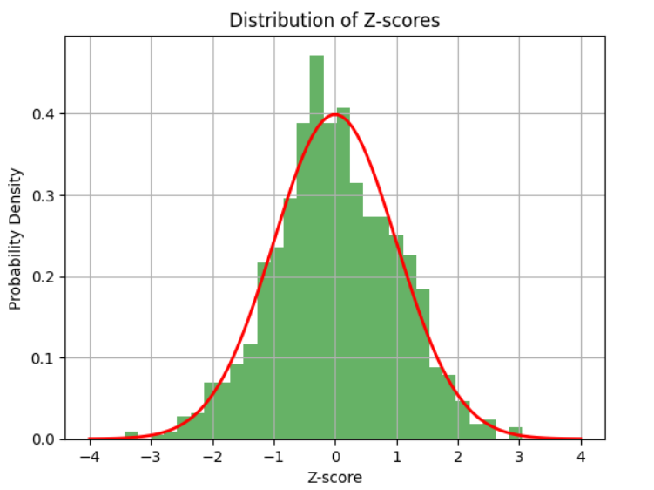
Hypothesis tests for Team Comparision Analysis
Interpretation:there is no significant difefrence in the average in the average home_club_goals and away_club_goals scored and the hypothesis testing process identifies the same…
There is no significant difference in the average number of yellow cards received by home teams and away teams.
Bell-Shaped Distribution: The shape of the histogram closely resembles the bell curve of the standard normal distribution. This suggests that the data from which these Z-scores were derived is approximately normally distributed.

Slide 11
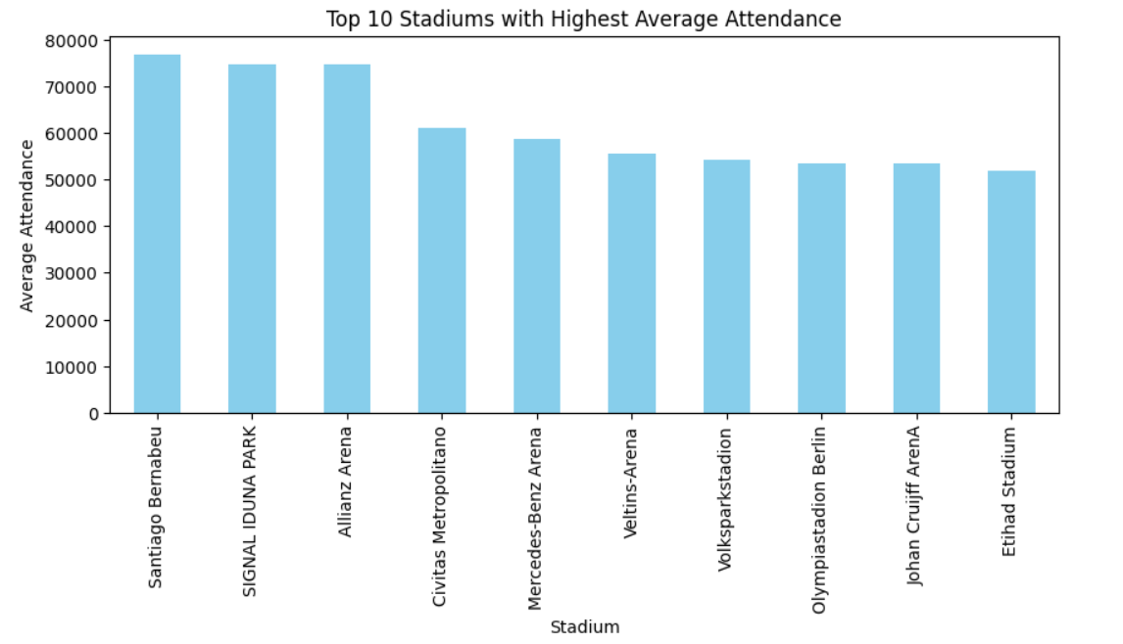
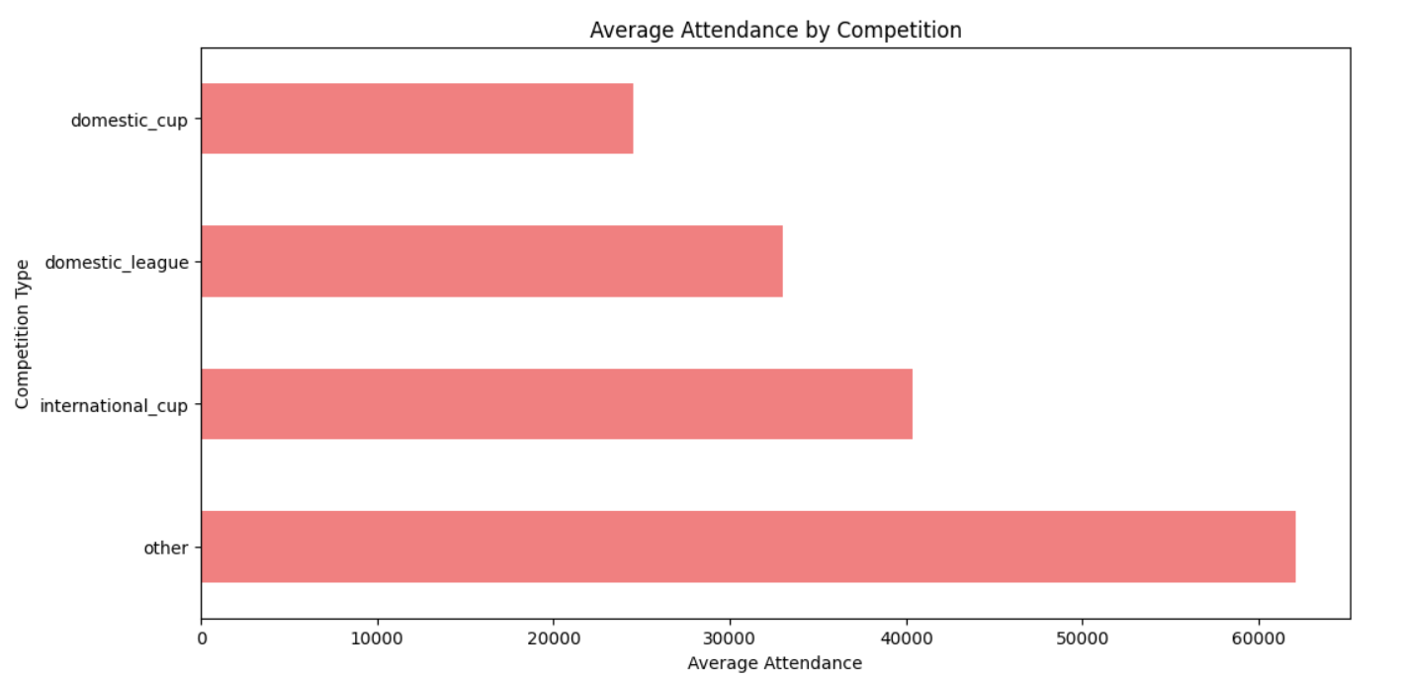
Attendance and Stadium Analysis
Interpretation: Santiago Bernabeu stadium has the highest average attendance... Signal Iduna Park is the top stadium based on average market value in eur….
The chart shows that "Other" competitions have the highest average attendance, followed by domestic leagues. Domestic cups have slightly lower attendance, and international cups have the lowest average attendance.

Slide 12
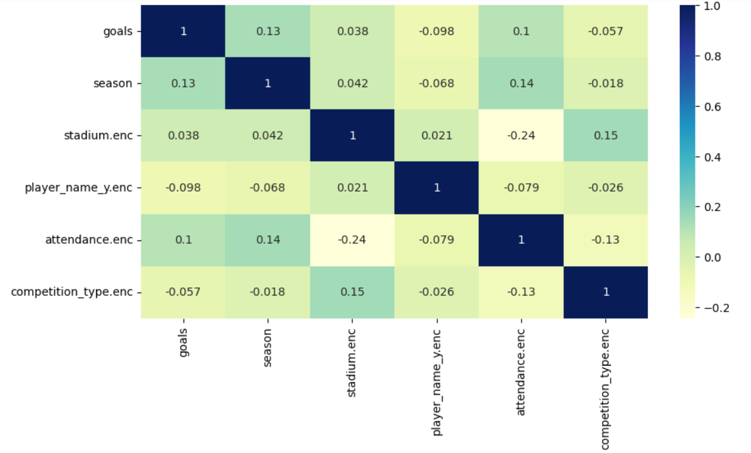
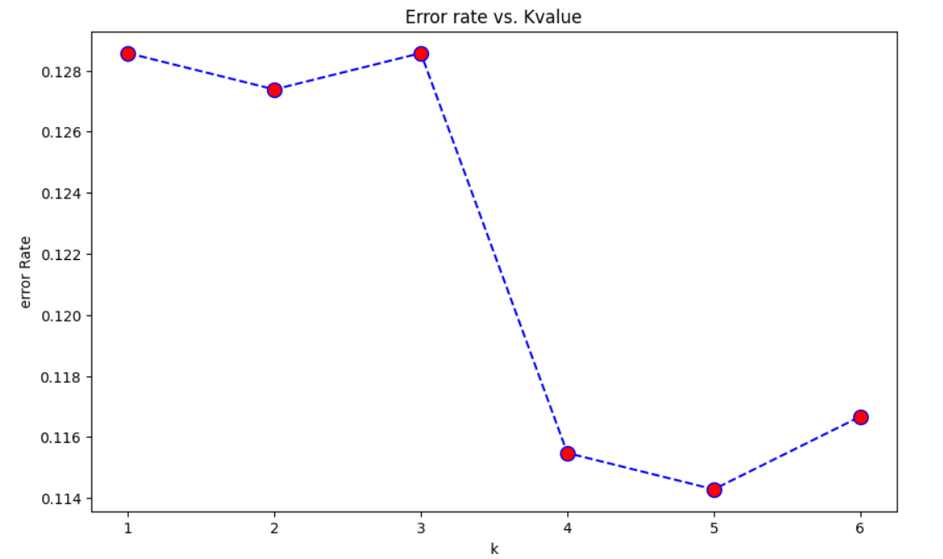
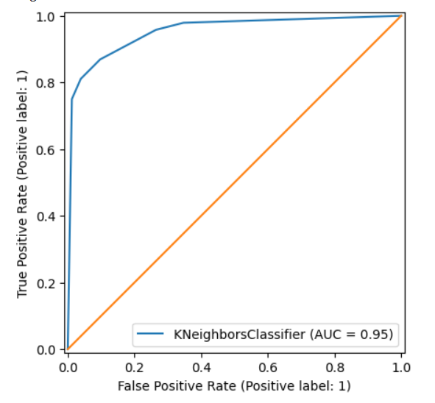
KNN Classification for predicting Attendance
Accuracy = 88.57%
Recall = 86.91%
F1_score = 88.57%
Precision = 90.29%
Interpretation: The results suggest that the KNN model performs well in predicting player attendance. The high AUC, accuracy, recall, F1-score, and precision indicate that the model is able to accurately identify players who are likely to attend and minimize false positives and false negatives.

Slide 13
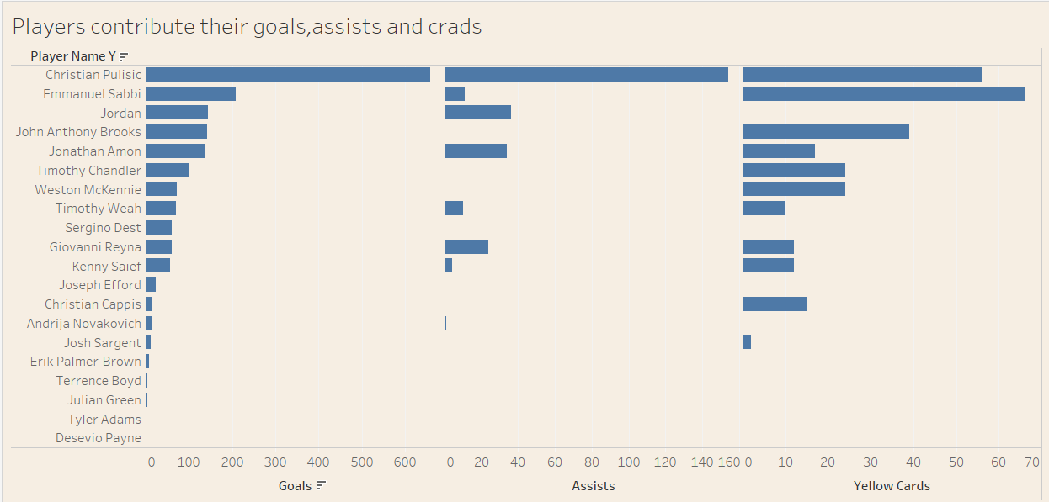
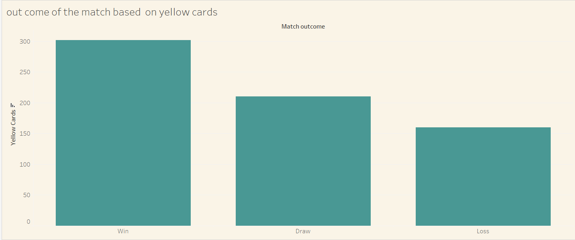
Event Analysis
Interprretation:Christian Pulisic: Stands out as the player with the highest number of goals, indicating his significant goal-scoring contribution.Assist Leaders: Players like Jordan and Emmanuel Sabbi have a higher number of assists, suggesting their key role in creating scoring opportunities for their teammates. Some players have a higher number of yellow cards, indicating a potential disciplinary concern or a more aggressive playing style.
Most Yellow Cards in Wins: The bar for "Win" is the tallest, indicating that more yellow cards are issued in matches that end in a win. This might suggest that winning teams are more aggressive in their play, leading to more fouls and, consequently, more yellow cards.

Slide 14
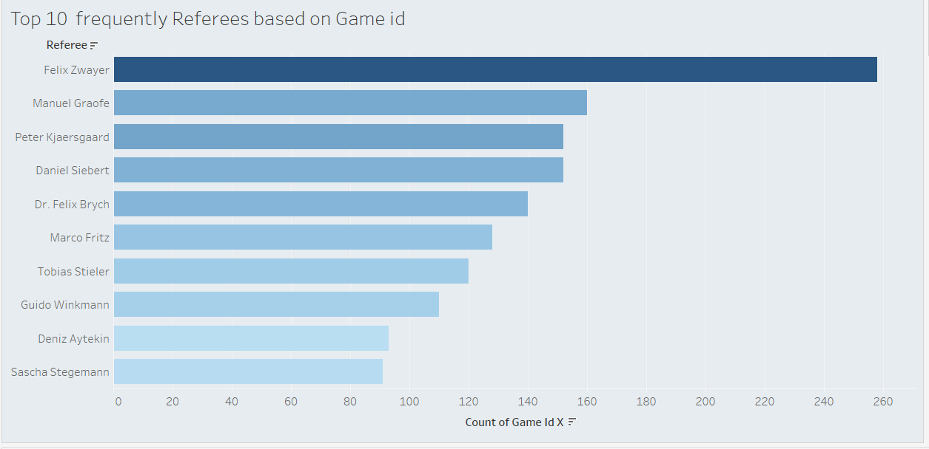
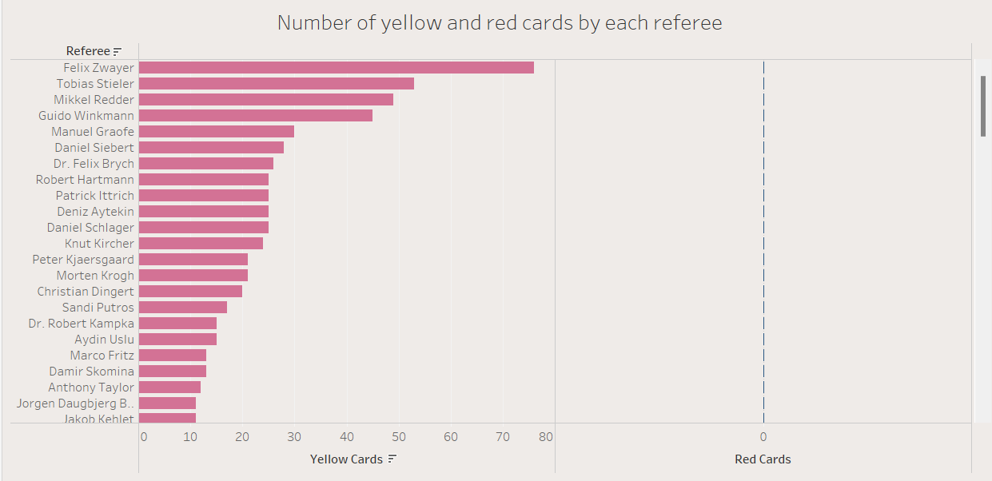
Referee Analysis
Interpretation:Felix Zwayer: Leads the list with the highest number of game assignments, indicating he is one of the most frequently appointed referees.
Manuel Grafe: Comes in second place, suggesting a high level of experience or a preference for his officiating style.
Felix Zwayer: He stands out with the highest number of cards issued, indicating a more proactive approach to card distribution.
Distribution: The distribution of cards varies significantly across referees. Some have issued a high number of cards, while others have a relatively low count. There no red cards in this data….

Slide 15
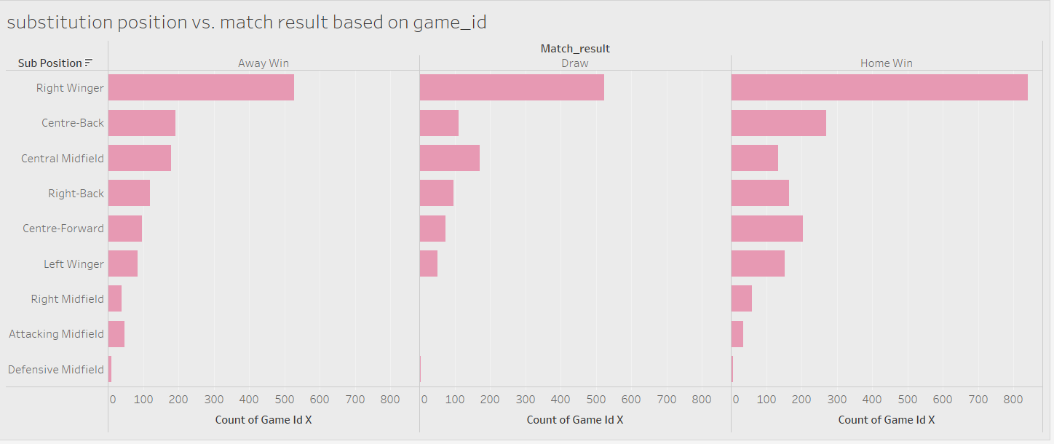
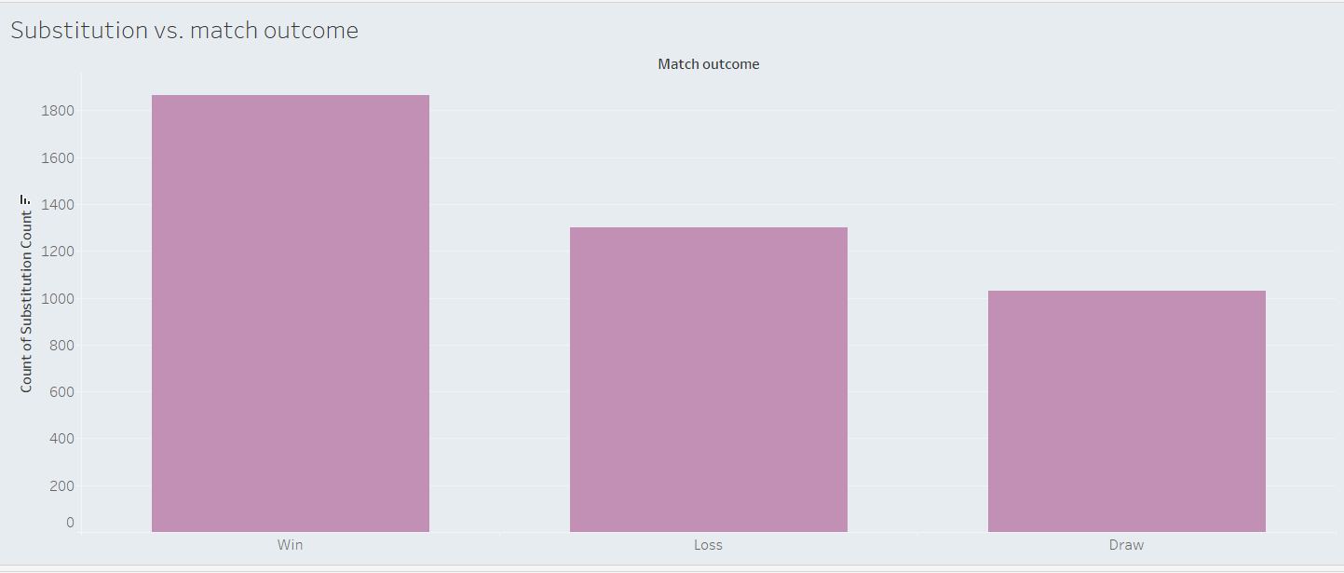
Substitution Analysis
Interpretation:Most Substitutions in Wins: The bar for "Win" is significantly taller than the bars for "Loss" and "Draw." This suggests that teams tend to make more substitutions when they are winning..
Home Win: The "Right Winger" position has the highest number of substitutions in matches resulting in a Home Win. Draw: The "Centre-Back" position shows the highest number of substitutions in drawn matches. Away Win: The "Defensive Midfield" position has the highest number of substitutions in matches resulting in an Away Win.

Slide 16
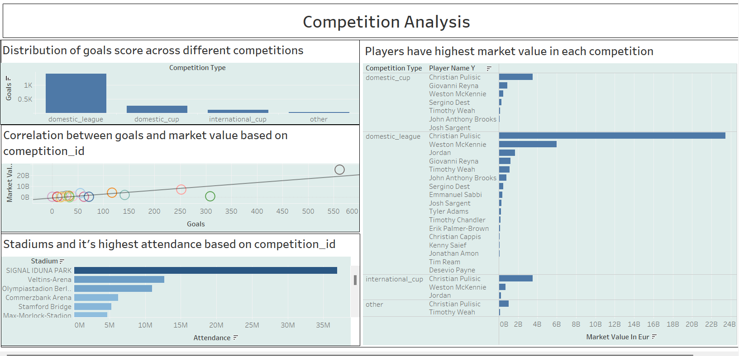
Interpretation:
Domestic_league competition type is the high distribution of goals score..
Signal Iduna Park stadium have high attendance based on count of competition_id….
CHRISTIAN PULISIC player have highest market value in every competition type like Domestic_cup, Domestic_league, International_cup and others….

Slide 17
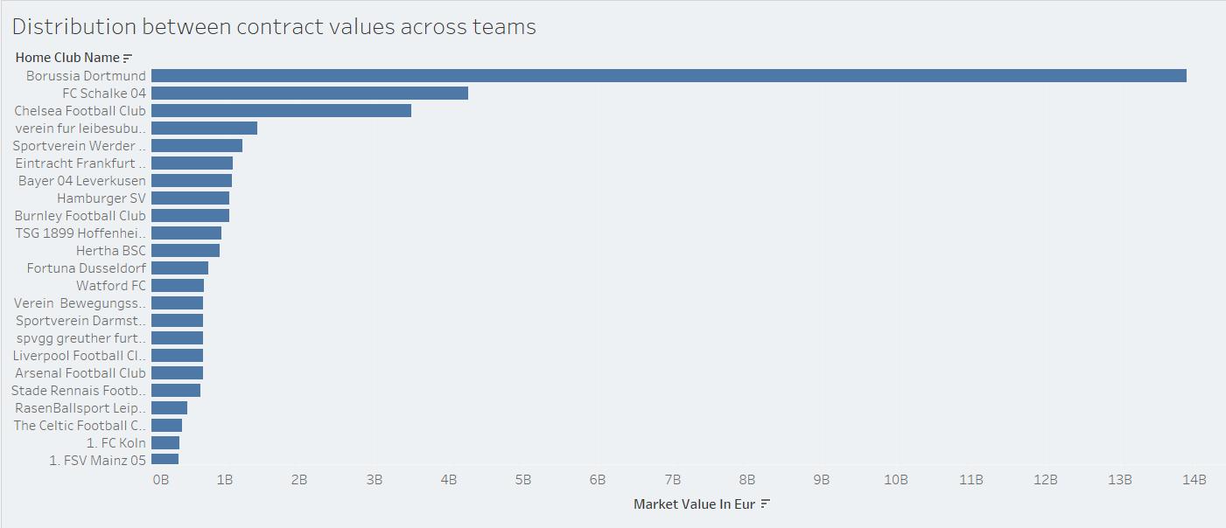
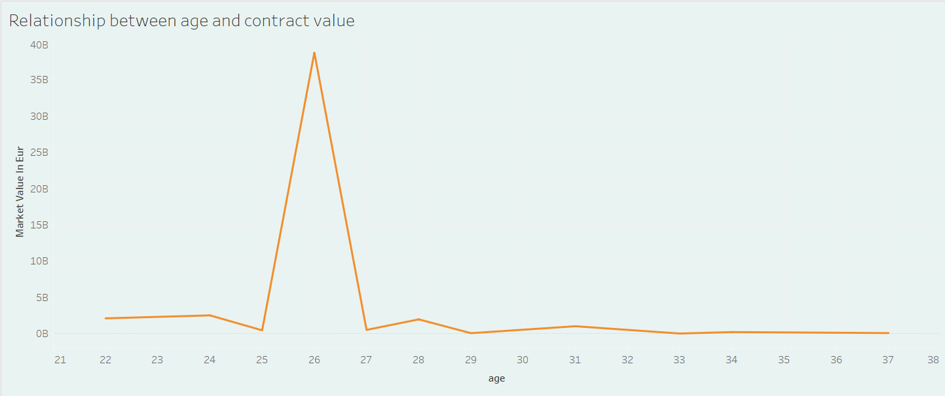
Contract Management
Interpretation:
Borussia Dortmund: Has the highest total market value among the teams displayed, suggesting a significant investment in high-value players.
Peak Value at Age 26: There is a sharp peak in the total market value around the age of 26. This suggests that players in their mid-twenties generally have the highest market values.

Slide 18
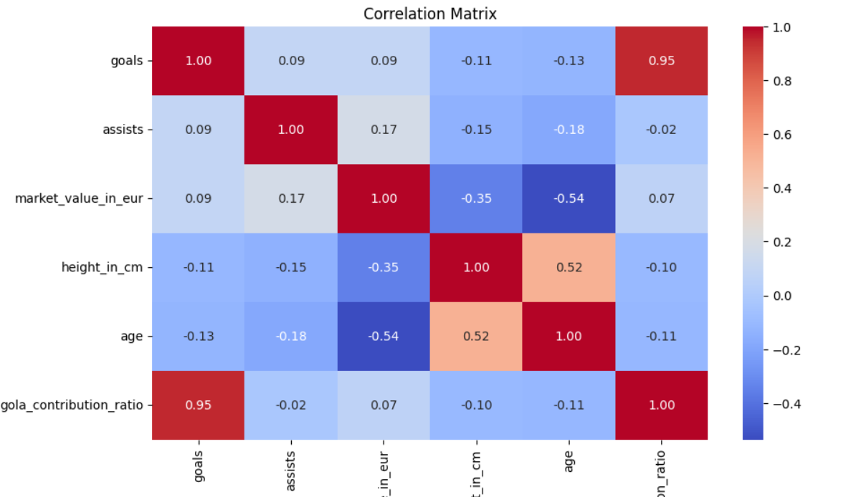
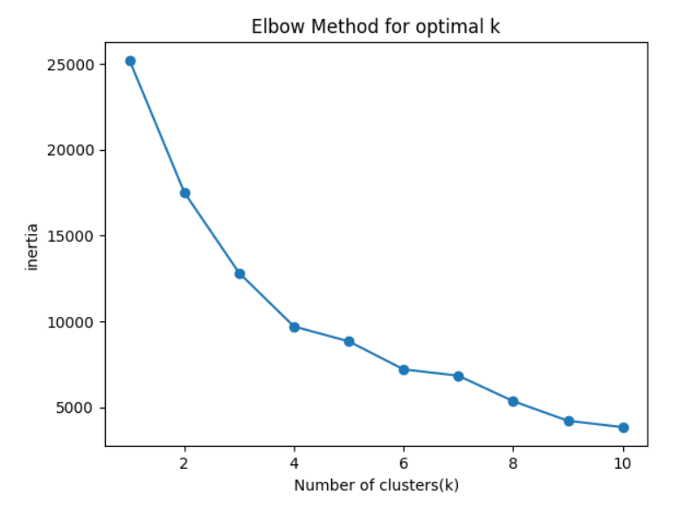
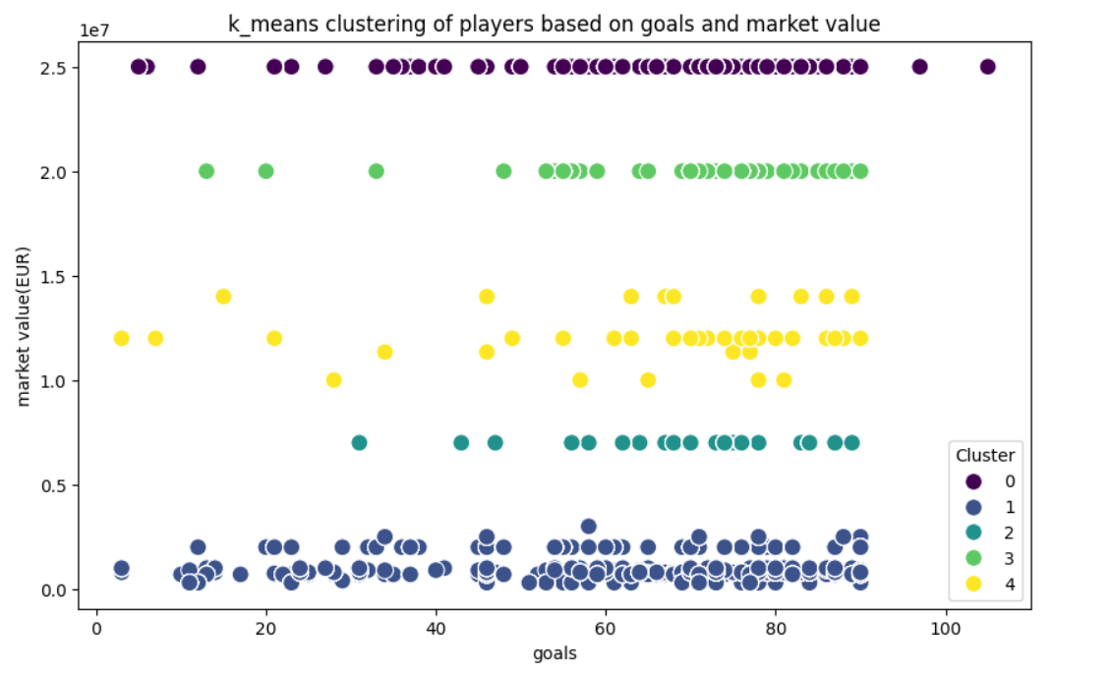
KMeans clustering for Player Attributes and Demographics
Interpretation:A silhouette score of 0.920 reflects strong clustering performance, meaning that the chosen number of clusters and the algorithm used have created well-separated and cohesive clusters. This suggests the clustering model is highly effective at grouping similar data points together while keeping different groups distinct.
A Calinski-Harabasz Index of 341426.68 suggests that the clustering model performs exceptionally well creating distinct and cohesive clusters with minimal overlap.
A Davies-Bouldin Index of 0.240 reflects outstanding clustering performance, indicating that the model has formed clusters that are both tight and distinct. Finally Kmeans model performance is also good….

Slide 19
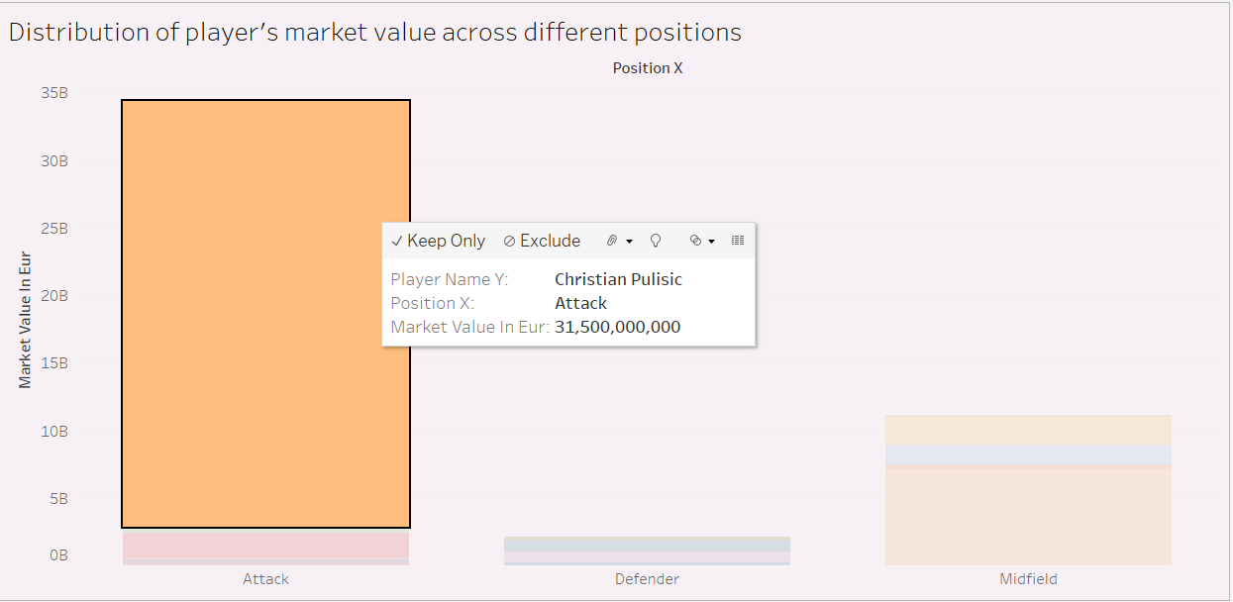
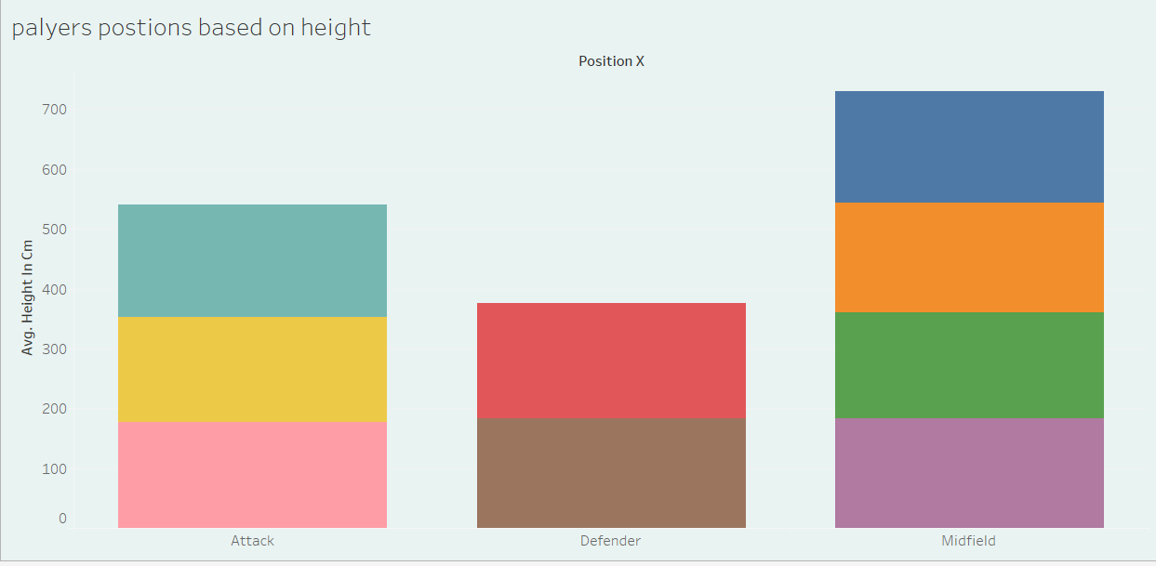
Player Attributes and Demographics
Interpretation:Christian Pulisic have higher market value in Attack position….John Antony brooks have highest market value in Defender position…Weston Mckennie have highest market value in midfield position….
Centre_Back have highest average height in Defender position..that is 192.35..

Slide 20
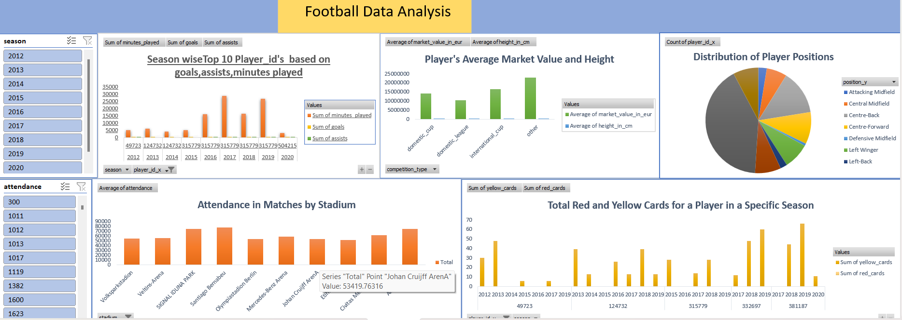

Slide 21
SUMMARY
Player Performance Trends: Key players like Christian Pulisic continue to stand out for their goal-scoring abilities, emphasizing their growing importance in attacking roles. Players such as Jordan and Emmanuel Sabbi excelled in assists, showcasing their creativity and vision in creating goal-scoring opportunities.
Team Dynamics: Borussia Dortmund’s strong goal-scoring capabilities place them at the forefront of offensive football, while FC Bayern Munich’s consistent fan engagement, with the highest home attendance
Managerial Impact: Thomas Tuchel’s superior number of wins compared to other managers reflects his managerial prowess, solidifying his reputation as one of the most successful coaches in the league during the period.
Market Value Insights: Players in offensive roles, such as right wingers and attackers, hold the highest market values. In contrast, defenders, particularly players like John Anthony Brooks, also hold significant market value.
Stadium Attendance Trends: Santiago Bernabeu stands out as the stadium with the highest average attendance, demonstrating Real Madrid’s global fan appeal. On the other hand, Signal Iduna Park leads in terms of average market value, suggesting it not only attracts fans but also houses some of the most valuable players.
Referee Patterns: Felix Zwayer emerges as the most frequently appointed referee, known for his proactive approach to card distribution, as evidenced by his high number of yellow cards.
Substitution and Strategy: Borussia Dortmund’s effective use of substitutions, particularly in the second half, plays a crucial role in their goal-scoring success. The strategy of maximizing fresh legs and adjusting tactics mid-game is a key element in their ability to capitalize on attacking opportunities.
Age and Market Value Trends: Players typically reach their peak market value around the age of 26, which signifies the prime years of a player's career.

Slide 22
Thank you

